Slide 1

Face Gender detection using CNN’s
Group 20
Sudhanshu Patil
Vaibhav Mittal
Rishab Kumar Pattnaik
Bhavya Garhwal
Notes:
hello everyone, welcome to this walkthrough presentation of our coding journey in simulating an Autonomous Collision Avoidance environment for satellites using Ursina game engine in python.

Slide 2
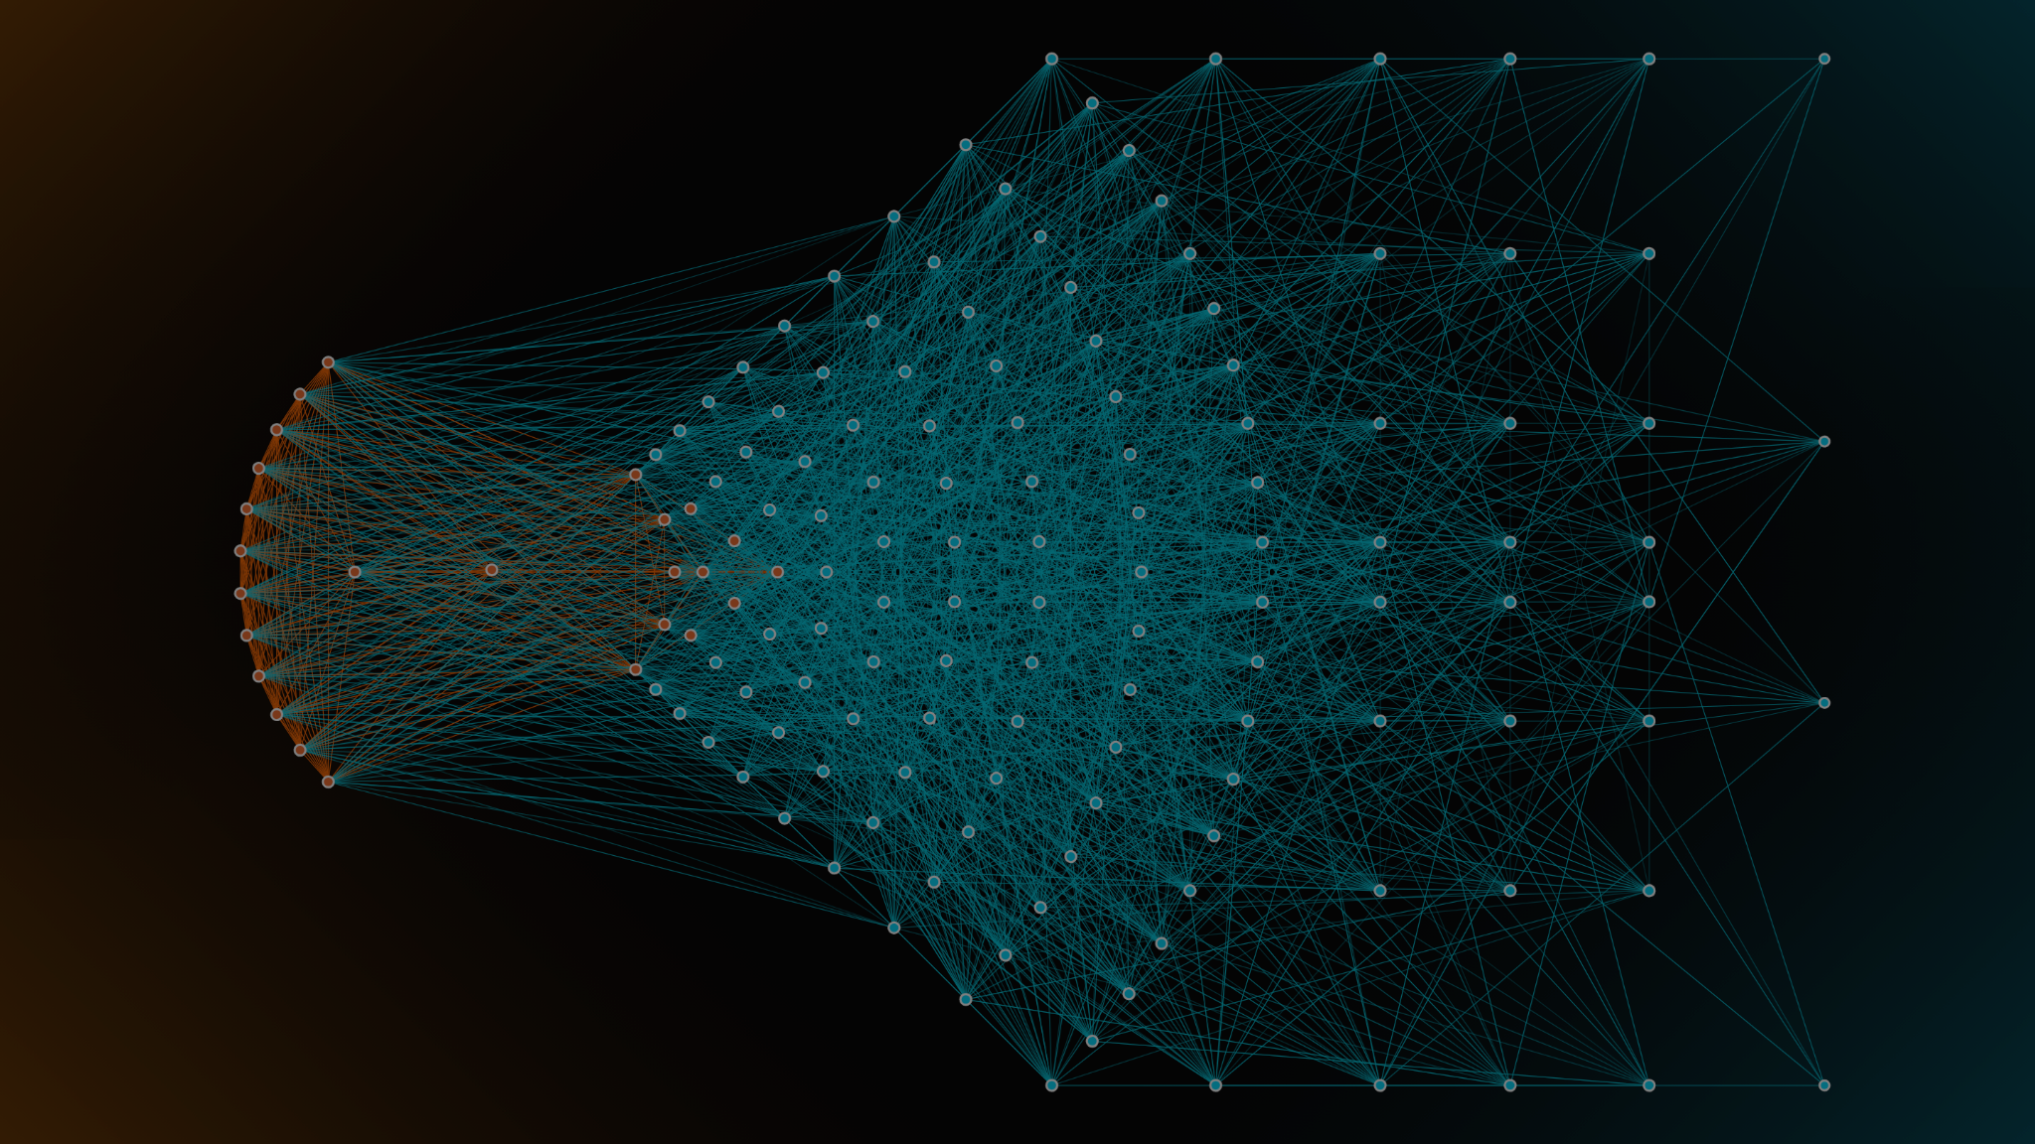
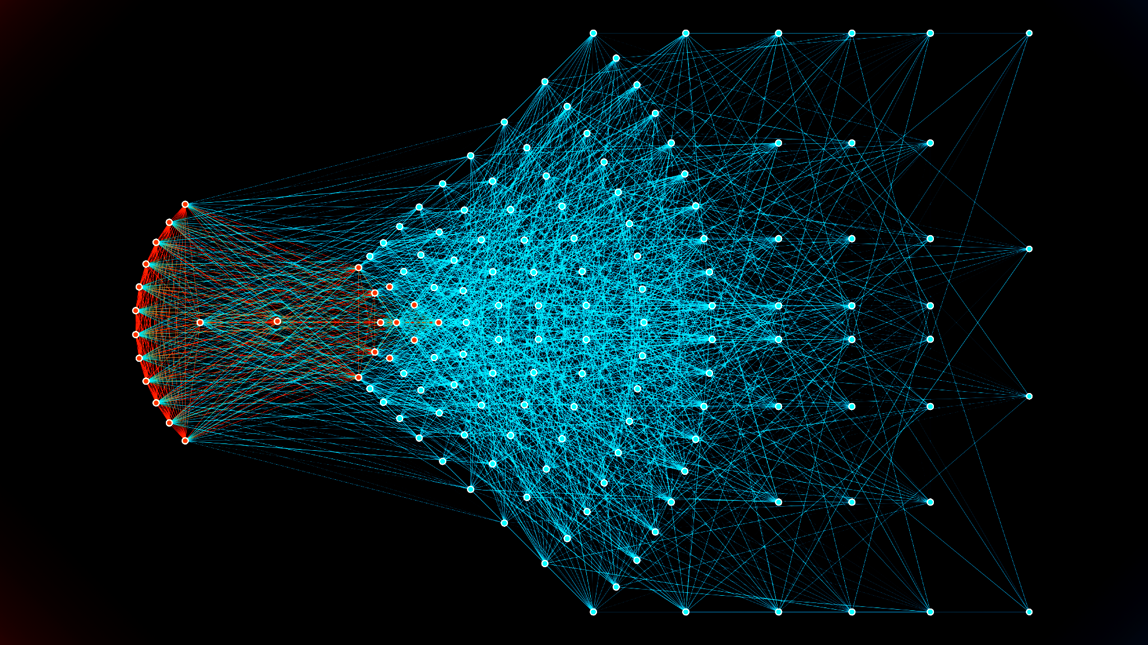

Introduction
Face Gender Recognition: Identifying a person’s gender from facial images using AI.
Importance:
Security Systems: Used in surveillance.
Customer Analytics: For targeted advertising and user insights.
Human-computer interaction: Enhances personalized services.
Why CNNs?
CNNs excel at extracting image features, making them ideal for tasks like gender classification. Their ability to capture spatial patterns boosts accuracy in image-related tasks.
Scope:
Build and train a CNN model to accurately classify gender based on facial images, with a focus on performance evaluation and comparison to benchmarks.

Slide 3
Research Gaps
Existing Solutions: Current CNN-based gender recognition models show promise but have limitations.
Identified Gaps:
Accuracy Challenges: Standard models struggle to maintain accuracy, especially in edge cases or with low-quality images.
Real-Time Application: Many models are too computationally intensive for real-time use.
Fuzzy Logic Advantage:
Fuzzy logic enhances decision-making by handling uncertainty and ambiguity in image classification, offering improved flexibility in borderline cases (e.g., images with unclear gender features).

Slide 4
Objectives
Build a Hybrid Model:
Combine CNN for feature extraction with Fuzzy Logic for handling uncertainty in classification, aiming to enhance accuracy in gender recognition.
Real-Time Application:
Ensure the model is computationally efficient, making it suitable for real-time gender recognition tasks.
Fuzzy Logic Integration:
Use fuzzy logic to manage ambiguous or uncertain classifications, especially in images where gender features are less distinct.

Slide 5

Methodology
Dataset Overview:
202,599 face images of various celebrities.
10,177 unique identities, but names of identities are not given.
40 binary attribute annotations per image. (Arched_Eyebrows,Bald, Bangs, Heavy_Makeup, Big_Nose, Double_Chin, Chubby, etc.)
5 landmark locations (2 eyes, 1 nose and 2 for corners of the person's mouth.)

Slide 6
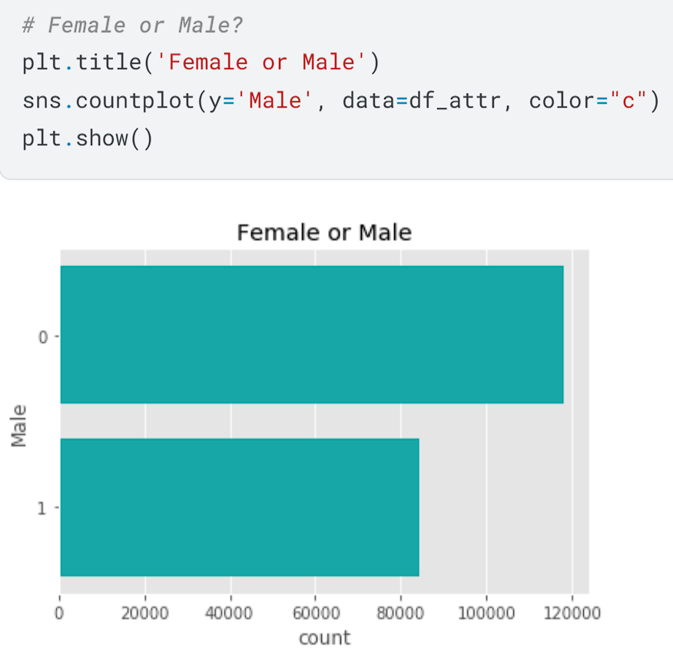
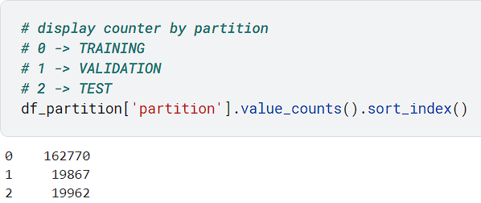
Methodology
Dataset Split:
The recommended partitioning of images is:
1-162770 for training set.
162771-182637 for validation set.
182638-202599 for testing set.
But, due to the large execution time, we will be using a reduced number of images:
Training set: 10,000 images.
Validation set: 2000 images.
Test set: 2000 images.

Slide 7
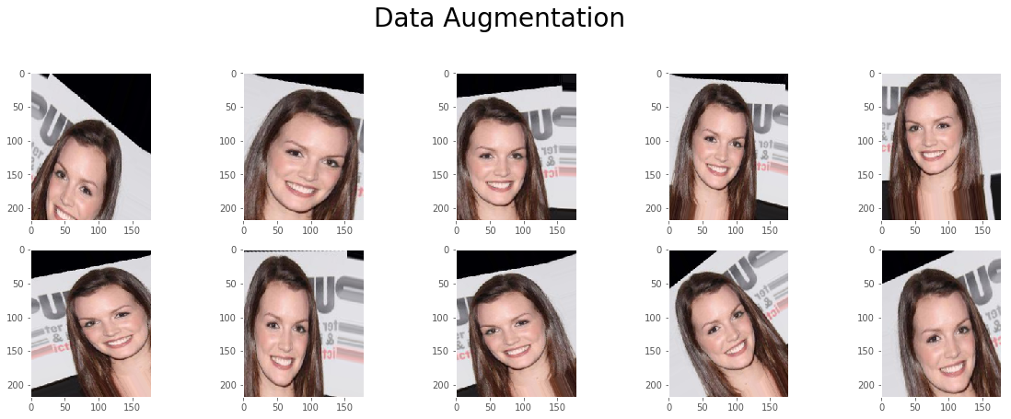
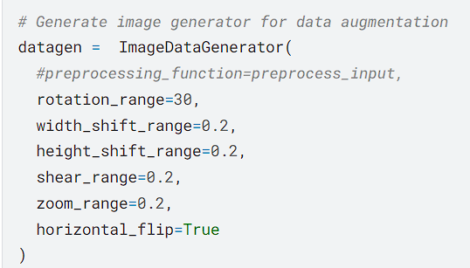
Methodology
Dataset Preprocessing:
Data Augmentation:
Data augmentation allows to generate images with modifications to the original ones. The model will learn from these variations (changing angle, size, and position), being able to predict better never seen images that could have the same variations in position, size, and position.

Slide 8
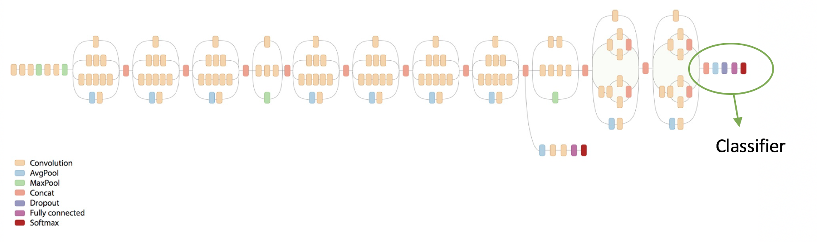
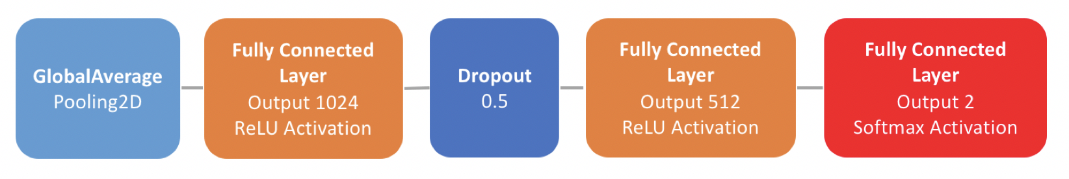
Methodology
Setting up the model— Inception v3
number of layers: 311
source: https://hackathonprojects.files.wordpress.com/2016/09/74911-image03.png
The top layers (including classification) are not included. These layers will be replaced for the following layers:

Slide 9
Methodology
Inception v3 model:
Overview: Inception v3 is a deep convolutional neural network architecture developed by Google as an improvement to earlier versions of the Inception models.
Total number of layers: 311
It consists of the following :
Convolution Layers (Extract features from the input image)
Avg/Mean Pooling Layers (Reduces spatial dimensions of the input by averaging)
Max Pooling Layers (Down-sample the spatial dimensions of the input)
Concatenation Layers (Combine multiple feature maps)
Dropout Layers (Certain percentage of neurons randomly set to zero in each iteration)
Fully Connected Layers (Connects every neuron from previous layer to neuron from current layer)
Softmax Layers (Converts raw output scores of the model into probabilities for each class)

Slide 10
Methodology
Why choose the Inception v3 model for face gender detection?
The architecture of Inception v3 consists of multiple parallel convolutional and pooling layers, called “Inception modules,” which are responsible for performing feature extraction from the input image, followed by fully connected layers that make the final classification decision.
The network uses convolutional filters of varying sizes to capture information at different scales, and the Inception modules allow the network to learn multiple patterns simultaneously.
It is trained on a large dataset, such as ImageNet, to learn the features and patterns that are relevant for tasks of image classification.
The pre-trained weights can then be used as a starting point for fine-tuning a smaller, specific dataset for a particular task, such as identifying the gender of a person based on their facial features.

Slide 11
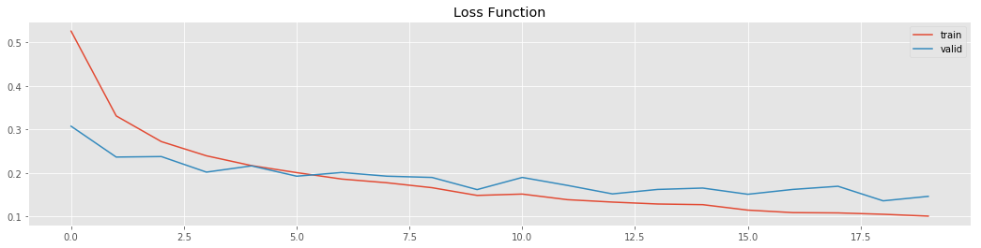
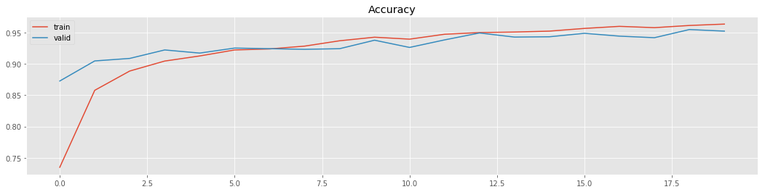
Results
Accuracy and losses for training and validation datasets:
Loss Function:
# Plot loss function value through epochs
plt.figure(figsize=(18, 4))
plt.plot(hist.history['loss'], label = 'train')
plt.plot(hist.history['val_loss'], label = 'valid')
plt.legend()
plt.title('Loss Function')
plt.show()
Accuracy:
# Plot accuracy through epochs
plt.figure(figsize=(18, 4))
plt.plot(hist.history['acc'], label = 'train')
plt.plot(hist.history['val_acc'], label = 'valid')
plt.legend()
plt.title('Accuracy')
plt.show()
Loss Function
Accuracy

Slide 12
Results
Evaluation metrics
The best model over the validation data got an accuracy of 96.40% and a loss of 0.1068.
Overall accuracy and loss of the best model over testing data are 95.75% and 0.115, respectively.

Slide 13
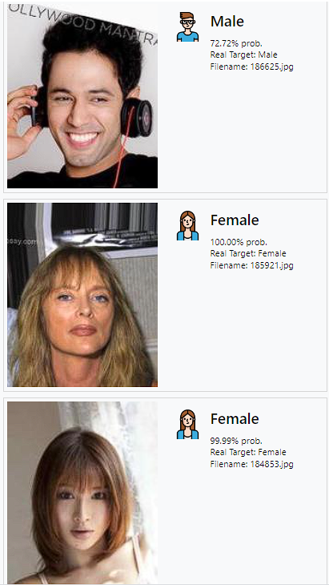
Results
Testing the output:
def gender_prediction(filename):
im=cv2.imread(filename)
im=cv2.resize(cv2.cvtColor(im,cv2.COLOR_BGR2RGB),
(178,218)).astype(np.float32) / 255.0
im = np.expand_dims(im, axis =0)
# prediction
result = model_.predict(im)
prediction = np.argmax(result)
return result

Slide 14
Conclusion and Scope of improvement
The built model, using transfer learning from Inception v3 with added custom layers, successfully recognizes the gender of a certain picture with 96.40% accuracy over the test data.
Nevertheless, there are some limitations detected and opportunities for improvements:
Train the model with the entire data set of images to improve prediction accuracy by exposing the algorithm to varied image contexts, giving it more experience to predict better never seen images.
Experiment with different CNN structures for potential performance gains, though this is resource-intensive.
Address dataset bias (close-up faces in CelebA) by adding preprocessing steps or diversifying the dataset with non-close-up images.

Slide 15
Future plan: Fuzzy Logic Integration
Fuzzy Membership Functions
Assign membership values to each class (e.g., a higher value for more confident predictions).
Fuzzy Inference System (FIS)
Use linguistic terms ("low," "high") to generate nuanced confidence scores.
Fuzzy Thresholding
Dynamically adjust decision thresholds based on prediction uncertainty.
Fuzzy Clustering
Preprocess data using fuzzy clustering to enhance features before classification.

Slide 16

Future plan: I/O UI for real-time analysis
We are also thinking about making a static HTML page that takes image input from the user and outputs the gender of the person in the image (constraints could be a single person per image).
If time limits, we are also thinking of using OpenCV for real-time gender prediction of people in front of the camera.
(Possible usecases: Security and surveillance, Targeted healthcare solutions, Facial recognition systems, Social media and content filtering, etc.)

